Slide 1

SMART INDIA HACKATHON · INTERNAL HACKATHON
AI-Powered Real-Time Detection and Prevention of Voice Cloning Impersonation Attacks
PROBLEM STATEMENT ID
THEME
26104
Blockchain & Cybersecurity
CATEGORY
TEAM NAME
Software
Deadlocked
TEAM LEADER
INSTITUTE
Rithwik Sriram (24f3001829)
IIT Madras BS Degree Programme
IITM BS Degree Programme · Presentation, Round 3 SIH Internal Hackathon

Slide 2
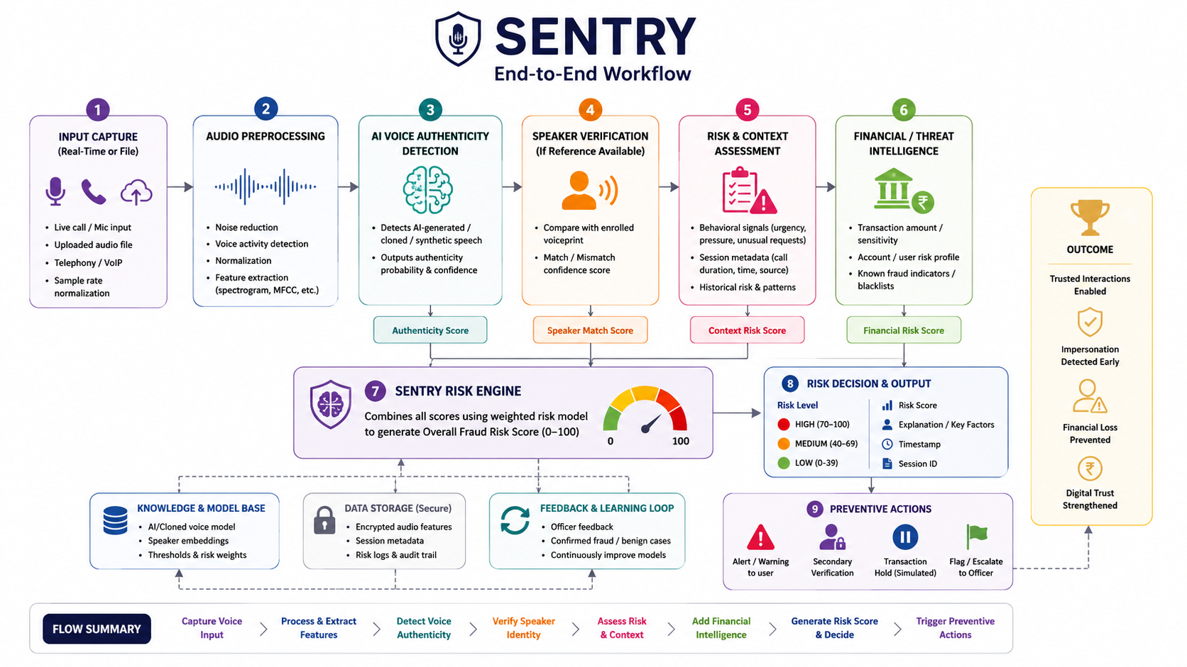
1
SECTION 01
Team Details
Member
Name
Role / Contribution
i
PROJECT OVERVIEW
Team Leader
Rithwik Sriram
Project Manager / Leader
Member 2
Sahil Singh
Backend
Member 3
Nawaz Ansari
AI/ML and Data Analysis
Member 4
Srilekha Dendukuri
Frontend
Member 5
S Dhinesh
CyberSecurity + Implementation
Member 6
Deeksha Jain
Research
IITM BS Degree Programme · SIH Internal Hackathon, Presentation
Section 01 of 08

Slide 3
2
SECTION 02
Idea , Approach and Proposed Solution
i
SENTRY
1
The Problem
Voice cloning is making trustworthy voices a vector of attack.
The AI voice technology can be used to mimic relatives, bank officials, employees, and other trustworthy people in order to make someone perform actions against their will. The current methods of detection concentrate only on recognizing fake audio.
Voice cloning has turned trusted voices into a new attack surface, enabling fraud, social engineering, and unauthorized access. SENTRY is an AI-powered real-time voice security platform that detects AI-generated speech, verifies whether the speaker matches the claimed identity, and assesses the overall risk of the interaction.
Unlike existing solutions that primarily focus on detecting fake audio, SENTRY combines voice authenticity, speaker verification, behavioural signals, and financial/transaction risk to determine whether an interaction can be trusted and trigger preventive actions such as warnings, secondary verification, or transaction holds.
2
Our Solution
SENTRY continuously analyzes speech in real time to detect synthetic voices, verify speaker authenticity and calculate impersonation risk. It can trigger warnings, secondary verification and simulated transaction holds before harm occurs.
3
What Makes It Different
Voice Authenticity + Identity Verification + Risk Intelligence + Prevention
SENTRY doesn't just detect a fake voice ,it determines whether the interaction can be trusted and what action should be taken.
IITM BS Degree Programme · SIH Internal Hackathon, Presentation
Section 02 of 08

Slide 4
3
SECTION 03
Novelty and Uniqueness
WHY SENTRY IS NEEDED
EXISTING SOLUTIONS
AI voice /deepfake detectors - detect synthetic audio, but mainly focus on authenticity.
Voice biometric systems - verify speaker identity, but may not detect AI-generated voices or assess fraud context.
Fraud/risk systems - assess transaction risk, but typically lack real-time voice authenticity and speaker analysis.
Voice is no longer a reliable proof of identity. AI voice cloning can convincingly imitate trusted individuals and be used for financial fraud, social engineering, and unauthorized access.
SENTRY bridges this gap by combining multiple signals into a single real-time trust and risk assessment: voice authenticity + speaker identity + behavioural/contextual risk + transaction sensitivity.
The goal is prevention, not just detection. Once risk crosses a defined threshold, SENTRY can recommend or trigger actions such as warning the user, requesting secondary verification, flagging the session, or holding a simulated transaction.
WHAT'S NEW
SENTRY combines all three: Voice Authenticity + Speaker Verification + Risk Assessment.
Real-time, end-to-end protection: detects → verifies → scores risk → triggers preventive action.
Goes beyond “Is this voice fake?” to “Can this interaction be trusted, and what action should be taken?
IITM BS Degree Programme · SIH Internal Hackathon, Presentation
Section 03 of 08

Slide 5
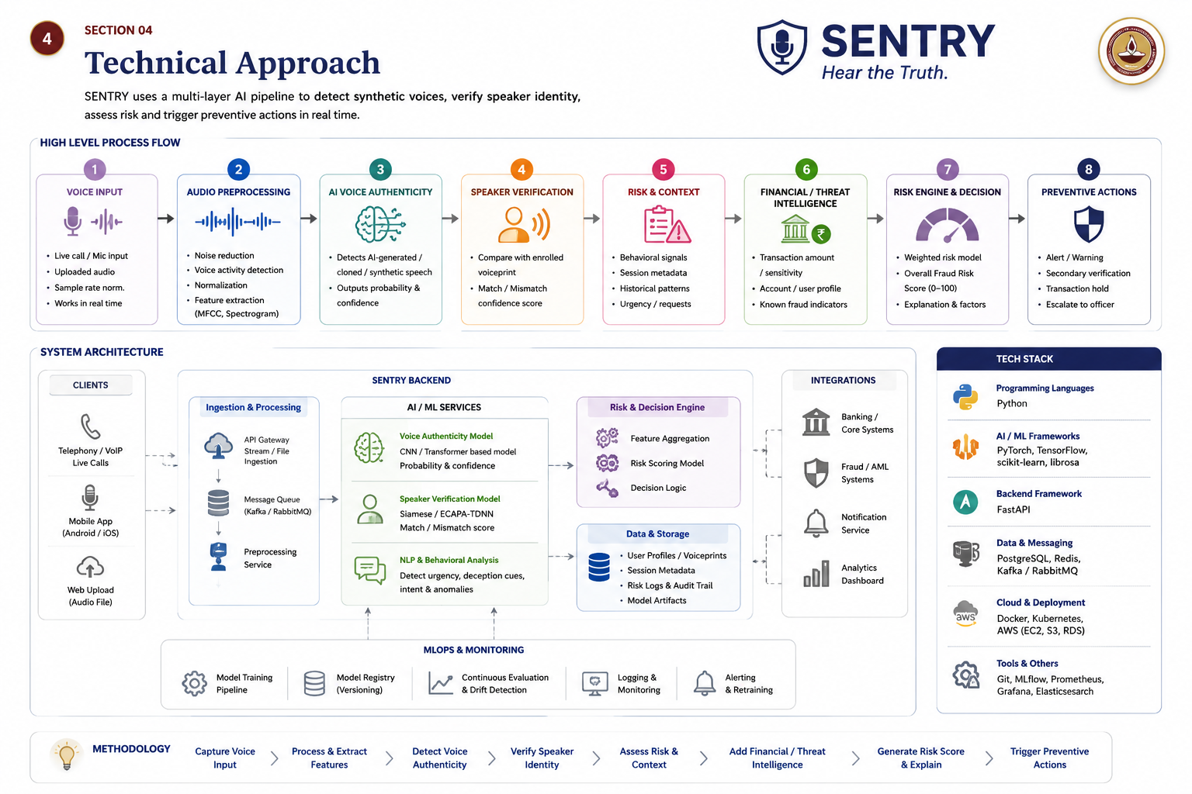
4
SECTION 04
Technical Approach
IITM BS Degree Programme · SIH Internal Hackathon, Presentation
Section 04 of 08

Slide 6
5
SECTION 05
Feasibility and Viability
!
Potential
Challenges
✓
Mitigation
Strategy
SENTRY is technically feasible using established speech-AI, speaker-verification and real-time streaming technologies.
The system can begin as a software prototype using microphone/live-call or uploaded audio, process speech in short windows, generate authenticity and speaker-match scores, and combine them with behavioural and transaction signals to produce a real-time risk score.
The architecture is modular, allowing models and risk rules to be improved independently as more data becomes available. For deployment, SENTRY can operate as an API/service layer and integrate with existing fraud, banking, telecom or enterprise systems rather than requiring replacement of existing infrastructure.
False positives / false negatives: Genuine voices may be flagged, while sophisticated attacks may evade detection.
Noisy real-world audio: Phone compression, background noise, microphones and network conditions can affect performance.
Limited speaker reference: Speaker verification is harder when no enrolled/reference voice is available.
Privacy & sensitive voice data: Voice recordings require strong protection, controlled access and limited retention.
Multi-signal risk engine: Don't rely on the deepfake detector alone; combine authenticity, speaker match, behavioural and transaction/context signals.
Confidence + escalation: Treat uncertain cases as “needs verification” rather than making an absolute genuine/fake decision.
Privacy-by-design: Minimize raw audio storage, encrypt sensitive data, restrict access and provide deletion/retention controls.
Human-in-the-loop prevention: High-risk cases trigger secondary verification, alerts or a simulated transaction hold rather than fully autonomous financial decisions
IITM BS Degree Programme · SIH Internal Hackathon, Presentation
Section 05 of 08

Slide 7
6
SECTION 06
Impact and Benefits
●
Social Impact
Protects individuals and institutions from voice impersonation, social engineering and unauthorized actions through real-time detection, warnings and secondary verification.
SENTRY creates meaningful social and economic impact by protecting individuals and institutions from voice-based impersonation, fraud, and social engineering.
By combining real-time voice detection, speaker verification, and risk assessment, it can help prevent unsafe interactions and reduce potential financial losses.
As a software-based solution, its primary value is in strengthening digital trust and security, with minimal direct environmental impact.
■
Economic Impact
Reduces potential fraud exposure by combining voice, identity, behavioural and transaction risk into a single actionable score.
▲
Environmental Impact
Software-first solution with minimal direct environmental footprint; optimized cloud/edge processing can support efficient digital security operations.
IITM BS Degree Programme · SIH Internal Hackathon, Presentation
Section 06 of 08

Slide 8
7
SECTION 07
Research and References
REFERENCES
ASVspoof Initiative, ASVspoof 2021: Speech Deepfake and Spoofing Detection, 2021. https://www.asvspoof.org/index2021.html
Jung, J.-W. et al., AASIST: Audio Anti-Spoofing using Integrated Spectro-Temporal Graph Attention Networks, 2021. https://arxiv.org/abs/2110.01200
Desplanques, B., Thienpondt, J., Demuynck, K., ECAPA-TDNN: Emphasized Channel Attention, Propagation and Aggregation in TDNN Based Speaker Verification, Interspeech, 2020. https://www.isca-archive.org/interspeech_2020/desplanques20_interspeech.html
Baevski, A. et al., wav2vec 2.0: A Framework for Self-Supervised Learning of Speech Representations, 2020. https://arxiv.org/abs/2006.11477
Hsu, W.-N. et al., HuBERT: Self-Supervised Speech Representation Learning by Masked Prediction of Hidden Units, 2021. https://arxiv.org/abs/2106.07447
Federal Trade Commission (FTC), Scammers Use AI to Enhance Their Family Emergency Schemes, 2023. https://consumer.ftc.gov/consumer-alerts/2023/03/scammers-use-ai-enhance-their-family-emergency-schemes
Federal Trade Commission (FTC), Fighting Back Against Harmful Voice Cloning, 2024. https://consumer.ftc.gov/consumer-alerts/2024/04/fighting-back-against-harmful-voice-cloning
CERT-In, Cyber Security Advisory — AI-generated Deepfakes and Impersonation, 2026. https://www.cert-in.org.in/
IITM BS Degree Programme · SIH Internal Hackathon, Presentation
Section 07 of 08

Slide 9
8
SECTION 08
Solution Summary
Criterion
Summary
Problem
Voice cloning can impersonate trusted individuals and enable fraud, social engineering, and unauthorized actions.
SENTRY is an AI-driven voice security system that offers real-time analysis of voice samples for signs of voice-cloning impersonation attacks. The system evaluates the speech coming in for synthetic voice characteristics, compares speaker identities with reference voices, and merges this data with behavior, context, and transactional data in order to arrive at the final risk score.
Unlike other solutions, which focus exclusively on detecting deepfakes, SENTRY takes the extra step of converting the process of detection into an action by raising alerts and prompting re-authentication.
SENTRY is built as a scalable trust layer that will work with banking systems, fintechs, telecommunications, enterprises, and other digital communications. The main purpose of the solution is to make decisions about user interactions and not just about whether their voice is authentic or not.
Proposed Solution
SENTRY detects synthetic speech, verifies speaker authenticity, assesses interaction risk, and enables real-time preventive action.
Novelty / USP
Voice Authenticity + Identity Verification + Risk Intelligence + Prevention in one unified real-time system
Feasibility
Built using established speech-AI, speaker-verification, backend, and real-time processing technologies with a modular architecture.
Impact
Protects users and institutions, reduces potential fraud exposure, and strengthens trust in digital voice-based communication.
IITM BS Degree Programme · SIH Internal Hackathon, Presentation
Section 08 of 08

